Slide 1



Python Tsunami
– April 21st-23rd –

Slide 2





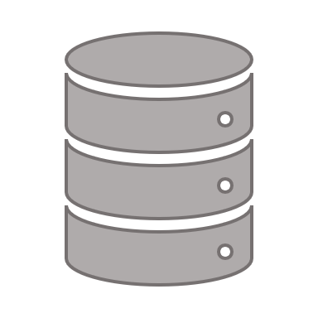




Center for Health Data Science (HeaDS)
https://heads.ku.dk
The Data Science lab:
Provides data science support for all research groups at SUND
Organizes courses
Research units:
work on different areas and topics within the field of health data science

Slide 3


The Team
Alberto Santos (HeaDS)
Annelaura Bach Nielsen (NNF CPR)
Davide Placido (NNF CPR)
Henry Webel (NNF CPR)
Marilena Hohmann (HeaDS)
Philip Charles (DBI (Oxford, UK))
‪Rita Colaço (PRI)
Roc Reguant (NNF CPR)
Thilde Terkelsen (HeaDS)

Slide 4
Practical Things about the Course
Program
Coffee and Q&A
Teams
Breakout rooms
Datathon

Slide 5
Practical Things about the Course -- Program --
 | Wednesday 21st April | Thursday 22nd April | Friday 23rd Friday
8:45-9:00 |  | Coffee and the day before (optional)
9:00-09:45 | Introduction and motivation | Conditions | Visualization I
9:45-10:00 | Coffee break
10:00-11:00 | Installation and tools | Loops | Visualization II
11:00-12:00 |  | Functions
 |  |  | Introduction Datathon
12:00-13:00 | Lunch break
13:00-14:00 | Variables and data types | Libraries | Datathon
14:00-14:45 | Numbers and operators | Scientific python
14:45-15:15 | Coffee break
15:15-16:00 | Data structures | Pandas | Datathon
16:00-17:00 |  |  | Presentations
17:00-17:30 | Q&A |  | What else is there?

Slide 6
Practical Things about the Course -- Teams --
49 participants divided into 10 fixed teams
2 working modes:
Individual: exercises
Teamwork: discussions, practice and the Datathon

Slide 7
Practical Things about the Course -- Breakout Rooms --
Main room
Chat
TCH
TA
x 3
Teamwork rooms x 10

Slide 8
Practical Things about the Course -- Datathon --
A Datathon is a data-focused competition — given a dataset and a limited amount of time, participants are challenged to use their creativity and data science skills to:
Build
Dataset
Test
Solutions
Explore

Slide 9
Practical Things about the Course -- Datathon --
A Datathon is a data-focused competition — given a dataset and a limited amount of time, participants are challenged to use their creativity and data science skills to:
Build
Dataset
Test
Solutions
Explore

Slide 10
What will you learn in this course?
Tools to work with Python
The basics of Python
Some of the most relevant scientific libraries
Visualization
Good practice

Slide 11
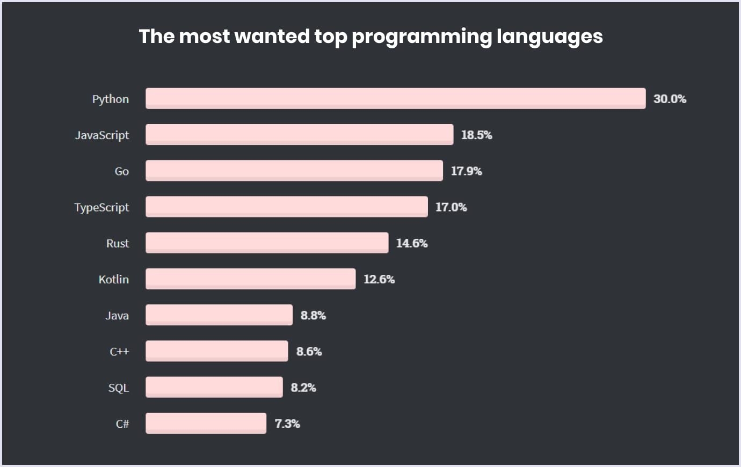
Why Python?
Python is easy to use, powerful, and versatile
A great choice for beginners and experts alike
Python’s readability makes it a great first programming language
It has a huge community behind developing useful libraries in many different fields (i.e biology, imaging, etc.)

Slide 12


Coffee with your team
Introduce yourself and what you do
Explain your motivation to take the course
Discuss what data could be relevant for you

